Slide 1
Agentic AI Hackathon: Building Intelligent Agents with IBM Granite and LangFlow

Slide 2


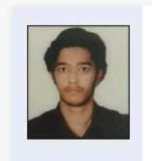
Name of the team: ClimaCrop
Details of Team members
TEAM MEMBER NAME | Recent Passport Photo | Email ID | Phone number [WhatsApp]
Inchara.S |  | incharaurs30@gmail.com | 9380207440
K P Nihaal |  | kpnihaal1725@gmail.com | 6366911112
Kushal K R |  | kushal.kr6002@gmail.com | 7483286722
i

Slide 3
Problem statement
AI-Based Climate Risk Assessment for Agriculture
Agriculture Agent
The Challenge
Climate variability significantly affects agricultural productivity through extreme weather events, shifting seasons, and unpredictable rainfall. Farmers and planners often lack tools to interpret climate data in an actionable manner. There is a need for an intelligent assistive system that can analyze climate trends and assess agricultural risk at a local level.

Slide 4
Need of project
Farmers cannot convert complex climate data, seasonal forecasts, and historical weather patterns into clear crop planning decisions that suit their local conditions and crop types.
No existing system effectively translates climate forecasts into crop-level risk detection such as identifying the possibility of drought stress, heat damage, delayed rainfall, or excess moisture that directly impacts yield.
Most current advisory platforms provide only generic suggestions that are not tailored to specific regions, crops, or real-time climate variability, making them less useful for practical farming decisions.
There is a strong need for an AI-driven, region-specific, and climate-resilient agriculture support system that can analyze climate trends, detect potential risks, and convert them into actionable, localized crop advisory for farmers.

Slide 5
End user of project
Farmers
Agricultural extension officers
Rural advisory centers
Agri-tech and climate-resilient agriculture initiatives

Slide 6
Technology Used
Langflow platform
Langflow component name – Agent , Chat input , Chat output
IBM Grainte model - for eg – ibm-granite-3-2-8b
IBM Cloud
RAG if used
IBM Watsonx.ai
Watsonx

Slide 7
Novelty and Uniqueness
Uses a multi-agent GenAI architecture instead of a single prompt-based system for agricultural decision support.
Merges climate analysis, crop knowledge, and regional specialization to generate localized, risk-aware advisory for farmers.
Integrates IBM Granite with RAG-based retrieval of climate-smart agriculture guidelines to ensure accurate and reliable recommendations.
Provides climate-risk–aware crop planning rather than generic agricultural suggestions.
Designed to be easily scalable across multiple crops and regions by modifying agent roles and instructions.

Slide 8
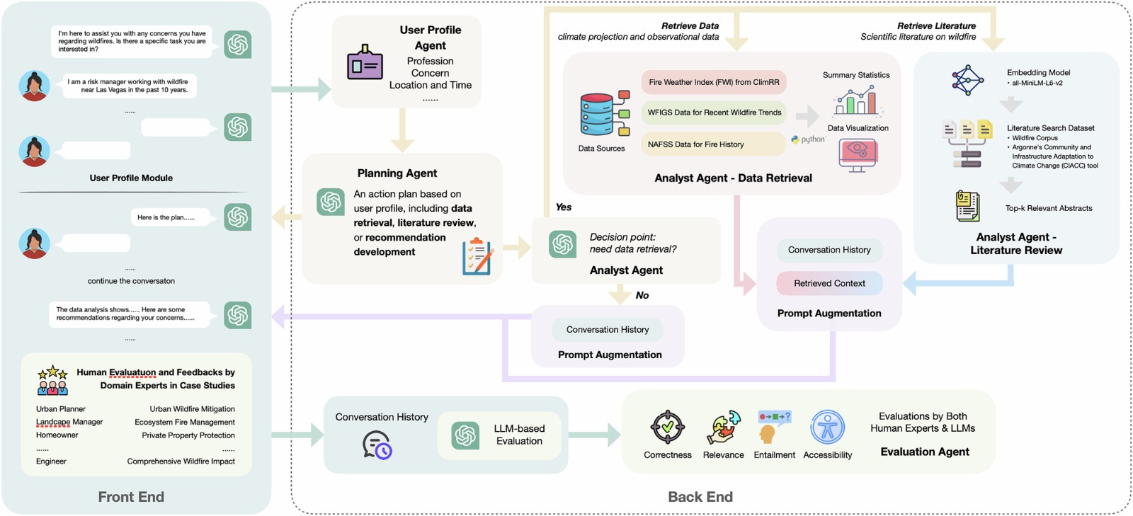
Technical flow diagram - Architecture blueprint

Slide 9
Langflow component Used
1) Chat Input
This component serves as the starting point for your retrieval flow. It provides a user interface to capture questions or queries from the user, which are then passed through the pipeline to generate a response.
2) IBM watsonx AI Agent
These specialized agent components (e.g., Climate Risk, Advisory, and Planning) act as domain experts. They use a foundation model to process the retrieved context and user questions, following specific "Agent Instructions" to provide tailored advice or risk assessments.
3) File Component (Read File)
The Read File component is used during the ingestion phase to load your source data, such as the booklet-final-web.pdf. It extracts the raw content from the uploaded file so it can be processed into the database.
4) Chat Output
This is the final component in your retrieval flow. It receives the generated text from the AI agents and displays the final answer back to the user in the chat interface.

Slide 10
5) Other Components Used:
In addition to the ones mentioned above, your project relies on several critical helper components to make the RAG (Retrieval-Augmented Generation) system work:
Split Text: Breaks the large PDF content into smaller "chunks" (set to 1000 characters with a 200-character overlap) to ensure the AI can process the information effectively.
Embedding Model (IBM watsonx.ai): Converts text chunks into numerical vectors (mathematical representations of meaning) so that the database can perform semantic searches.
Astra DB: Acts as your vector database. It has two roles: Ingest Data (storing the document chunks) and Search Query (finding the most relevant chunks when a user asks a question).
Parser: Formats the raw data results retrieved from Astra DB into a readable string using a template (like {text}) so the Prompt component can use it.
Prompt: A template that combines the retrieved context from your files with the user's question to give the AI clear instructions on how to answer.

Slide 11
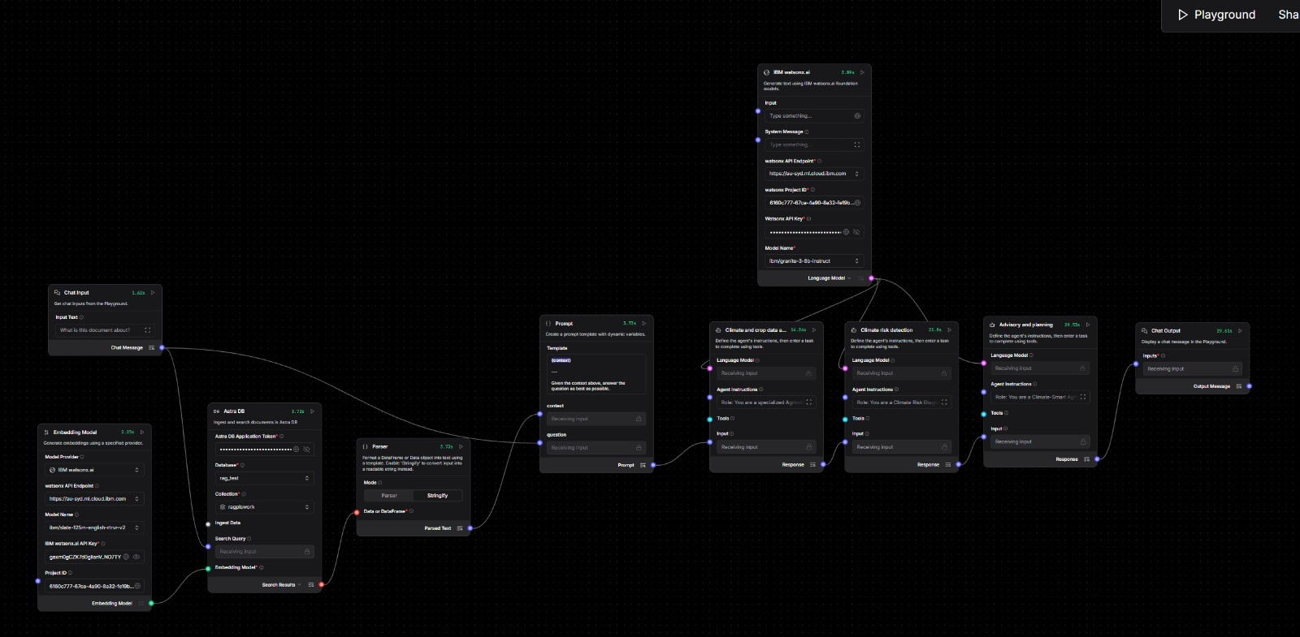
Input Screenshot 1

Slide 12
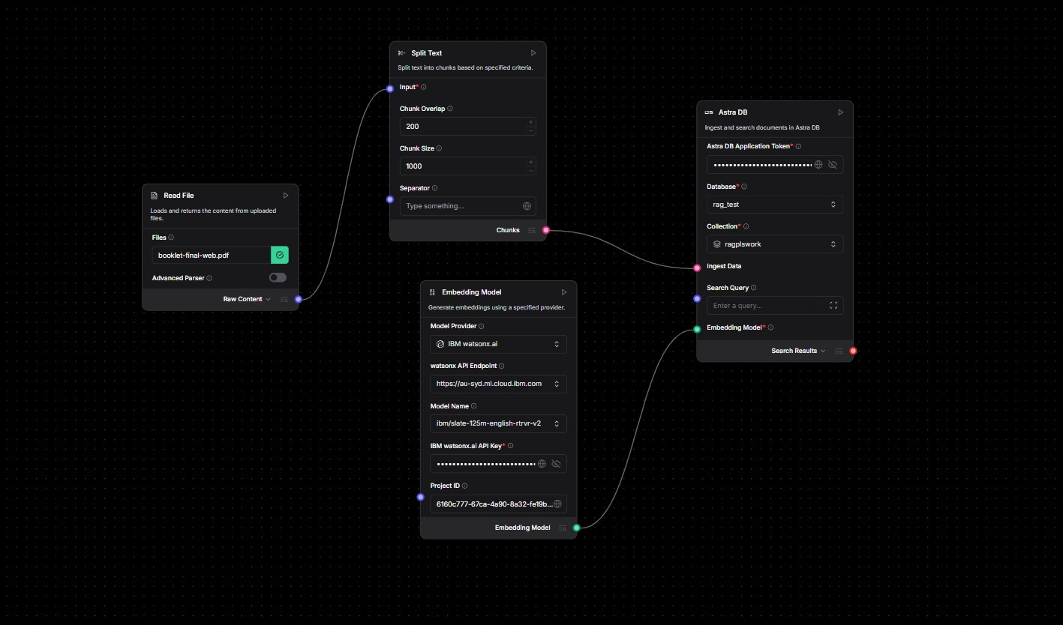
Input Screenshot 2

Slide 13
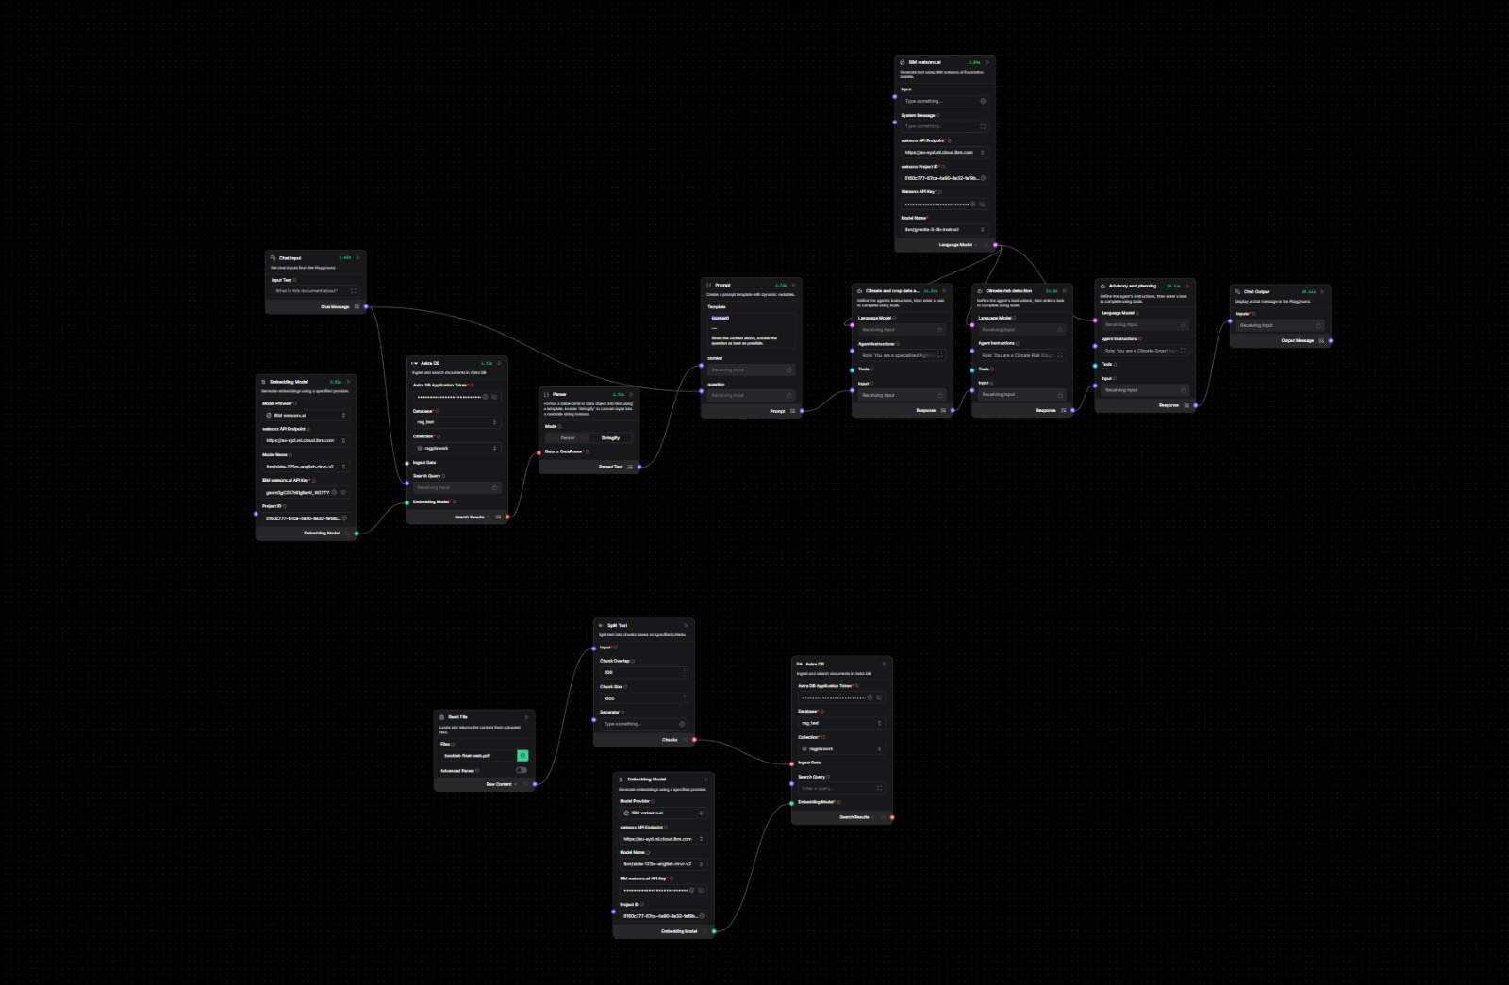
Input Screenshot 3

Slide 14
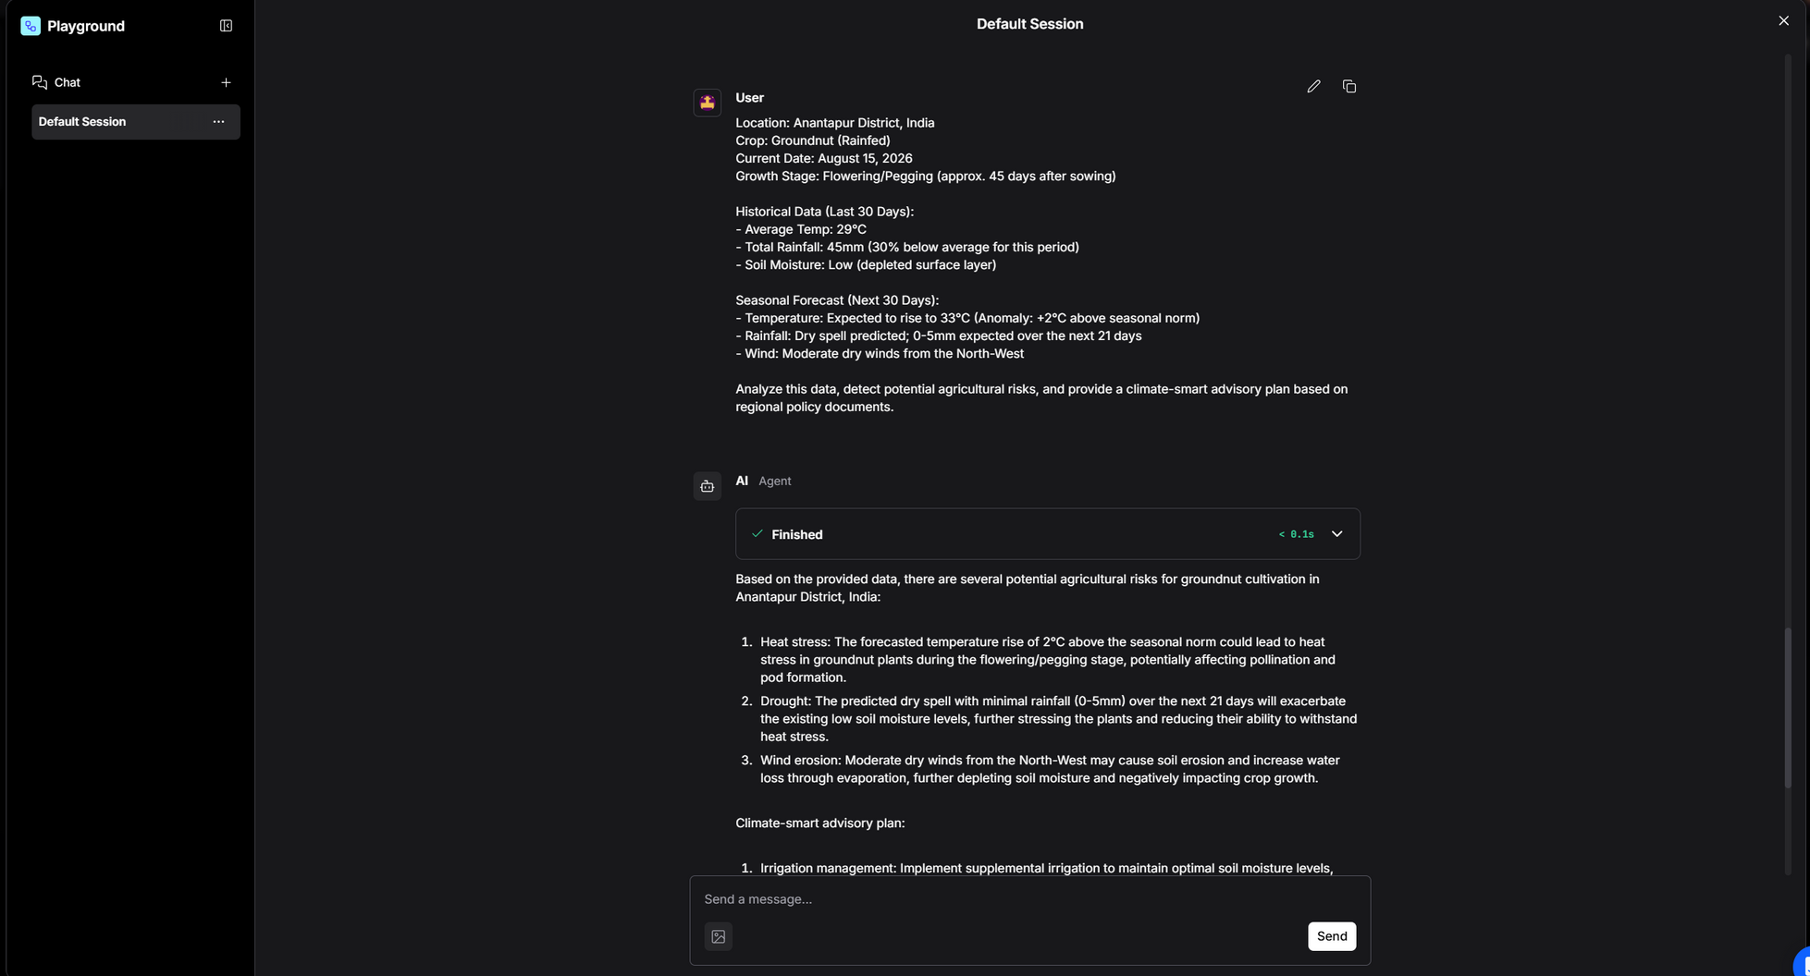
Output Screenshot 1

Slide 15
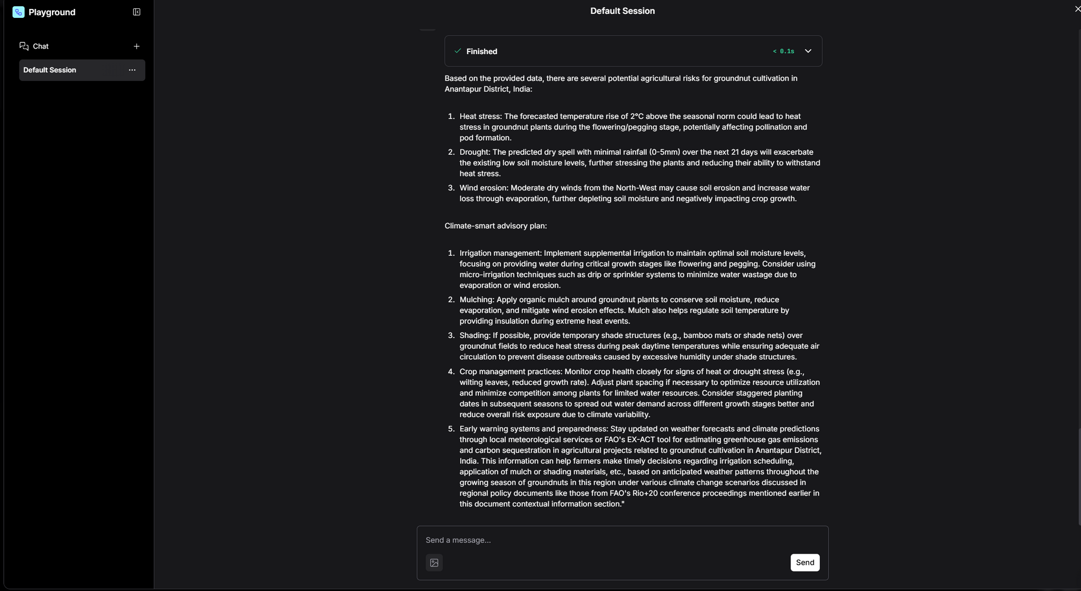
Output Screenshot 2

Slide 16
Future Scope
Integration with live weather forecast APIs to automatically ingest real-time rainfall predictions, temperature trends, humidity levels, and extreme weather alerts for more accurate and timely risk assessment. Expansion to support multiple crops and diverse regions across India by updating agent roles and region-specific crop knowledge, enabling a scalable nationwide advisory system. Development of a mobile application with voice-based interaction so farmers can access advisories hands-free in low-literacy and field conditions.
Integration with soil data and IoT sensor inputs such as moisture, temperature, and nutrient levels to combine ground data with climate analysis for precise recommendations. Implementation of a multilingual advisory system to deliver guidance in regional languages,
ensuring better accessibility and usability for farmers in rural areas.

Slide 17
Git Hub Link
https://github.com/Kp1725/ClimaCrop

Slide 18
References
IBM watsonx.ai official docs (general) —
https://www.ibm.com/docs/en/software-hub/5.1.x?topic=services-watsonxai
Langflow official documentation
https://docs.langflow.org
Climate Smart Agricultural Technologies for Rice (Odisha case)
https://icar-nrri.in/wpcontent/uploads/2023/05/Climate-Smart-Agricultural-Tech..pdf
Climate-Smart Agriculture for Rice Farming (Research Review)
https://www.researchgate.net/publication/372494382_CLIMATE_SMART_AGRICULTURE_FOR_RICE_FARMING_A_REVIEW

Slide 19
Thank You
edunet
In collaboration \Nith
IBM SkillsBuild
found Hon

